Slide 1


PAAVAI ENGINEERING COLLEGE
(AUTONOMOUS)
DEPARTMENT OF INFORMATION TECHNOLOGY
MOBILE APPLICATION DEVELOPMENT FOR TRACKING DAILY EXPENSES
BATCH NO: 8
GUIDED BY:
Mrs.K.Kanimozhi,
Assistant Professor,
Department of IT,
Paavai Engineering College.
PRESENTED BY: K.BOWTHIKA(20202008)
A.RAGHUL(20202038)
Final Year - IT
Paavai Engineering College.

Slide 2
INTRODUCTION
This project is an attempt to manage our daily expenses in a more efficient and manageable way. Sometime we can’t remember where our money goes. And we can’t handle our cash flow.
For this problem, we need a solution that everyone can manage their expenses. So we decided to find an easier way to get rid of this problem. So, our application attempts to free the user with as much as possible the burden of manual calculation and to keep the track of the expenditure.
Our proposed Expenses Daily expenses app aims to empower users with a user-friendly platform to effortlessly record and monitor their daily expenditures.

Slide 3
OBJECTIVES
The primary objective of our Daily Expenses App is to simplify the process of expense management for users.
By encouraging regular input of daily expenses, the app aims to promote financial awareness and discipline.
The end goal is to empower users to make informed financial decisions by providing them with clear and concise reports at the end of each day, facilitating a comprehensive understanding of their spending patterns.

Slide 4
TECHNOLOGY USED
We are using Flutter & Firebase go for our project.
Our app leverages cutting-edge technologies to ensure a seamless user experience.
Utilizing a mobile-friendly interface, the app will be available on both Android and iOS platforms.
The backend will be built on a robust and scalable, ensuring secure storage of user data.

Slide 5
METHODOLOGY
The development process will follow an agile methodology, allowing for continuous feedback and rapid iterations. The app will undergo thorough testing to ensure a bug-free experience, and user feedback will be actively solicited to enhance the app's usability. The user interface will be designed with a focus on simplicity. Regular updates and feature additions will be rolled out based on user feedback and emerging trends in personal finance management.

Slide 6
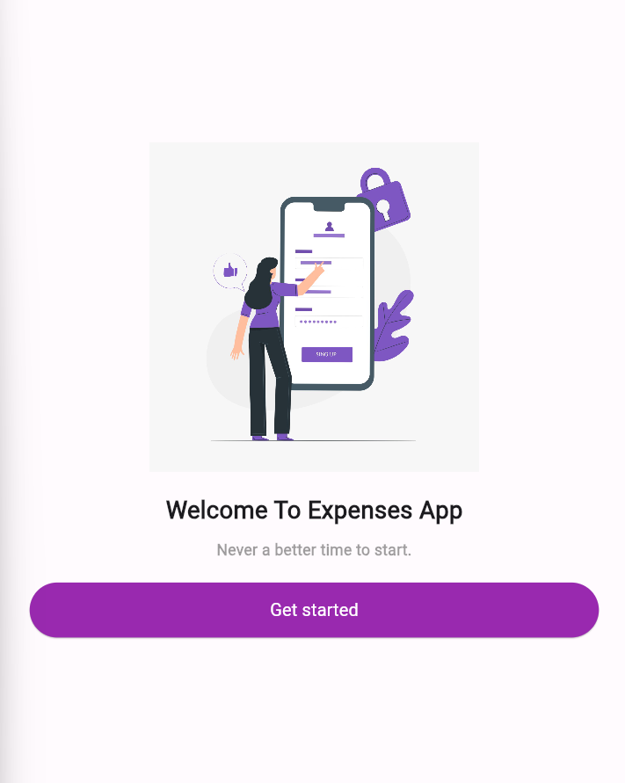
WELCOME SCREEN FOR DAILY SPENDZ APP

Slide 7
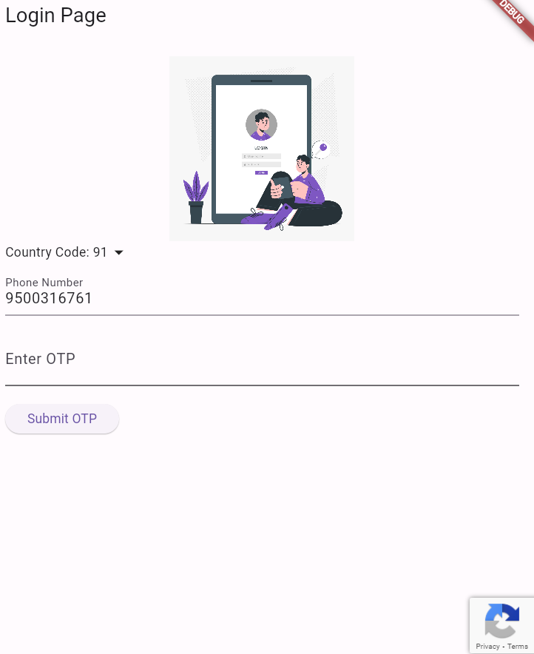
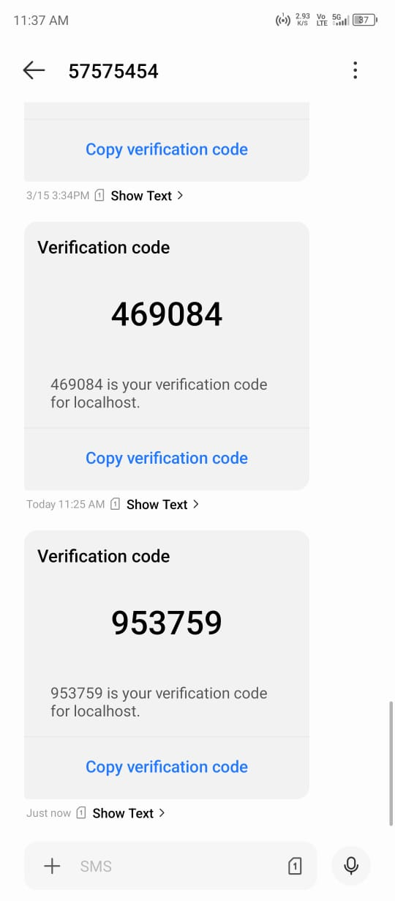
LOGIN PAGE & OTP SCREEN

Slide 8
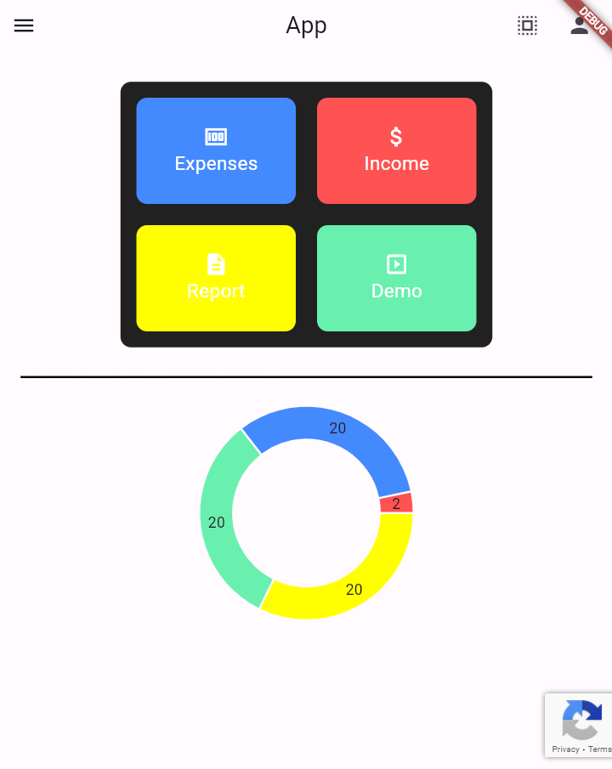
DASHBOARD:

Slide 9
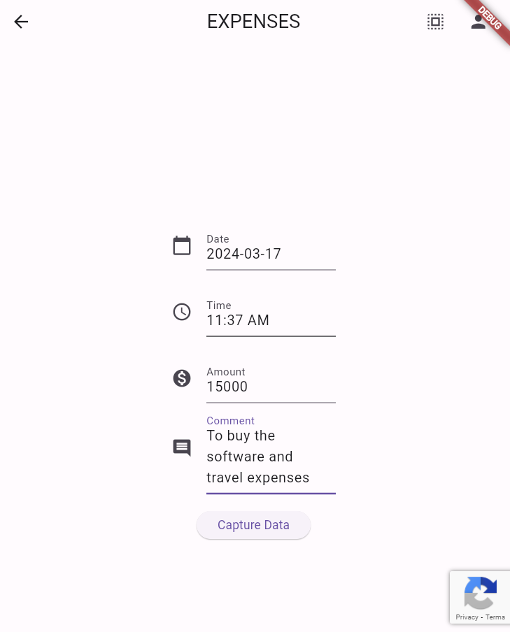
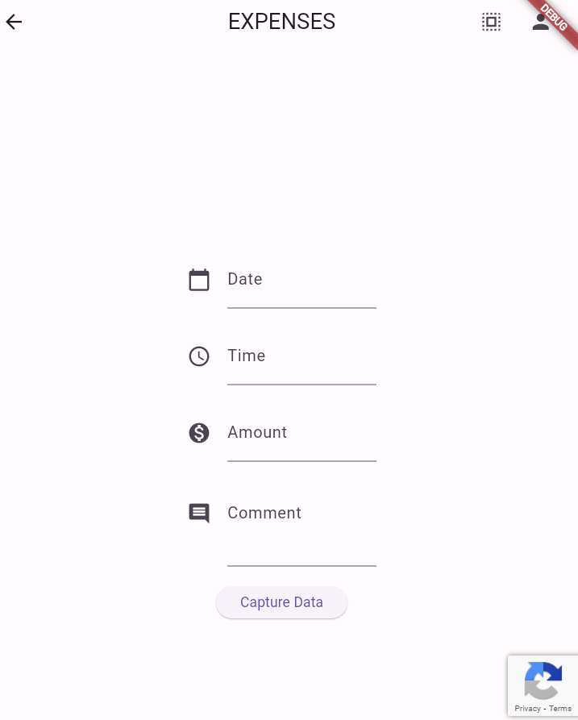
EXPENSES PAGE:

Slide 10
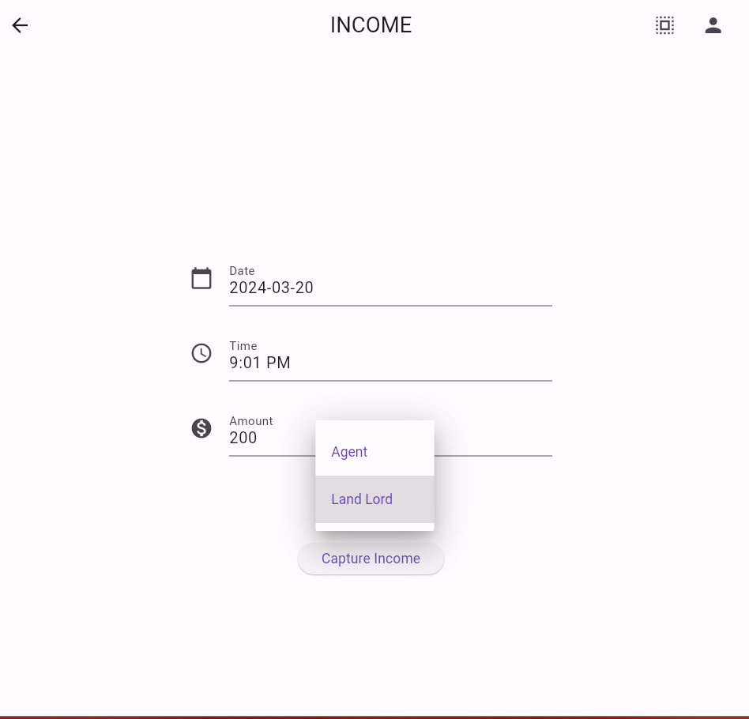
INCOME PAGE:

Slide 11
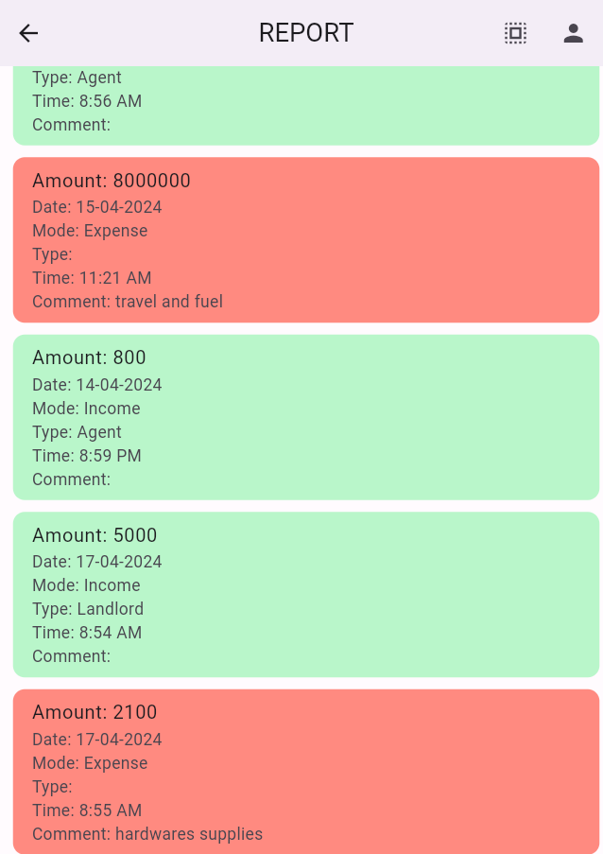
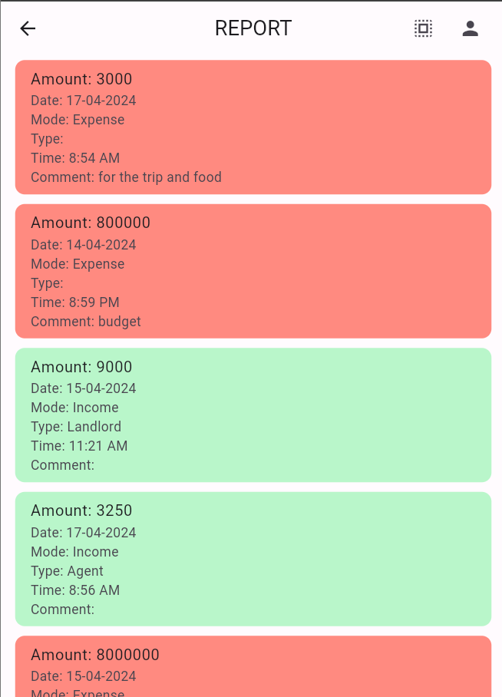
REPORT PAGE:

Slide 12
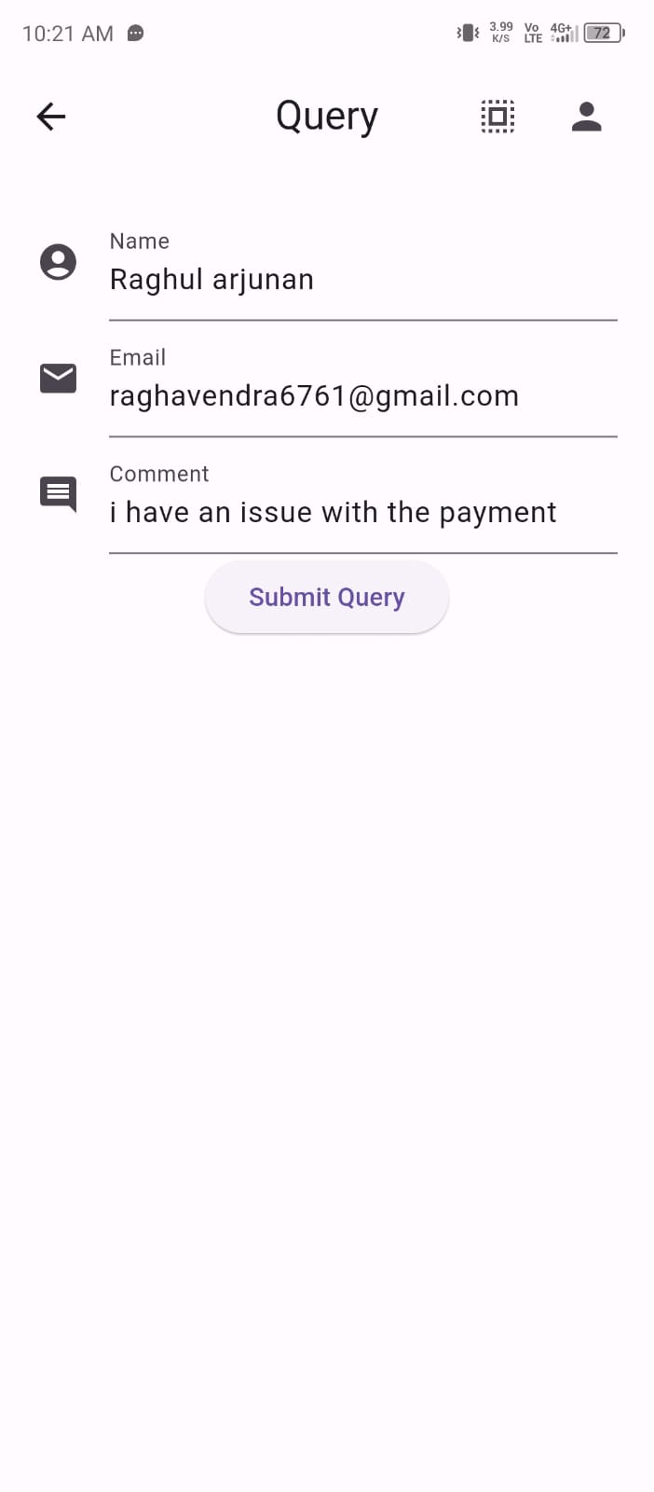
QUERY PAGE:

Slide 13
CONCLUSION
In conclusion, our Daily Expenses app is designed to empower users in taking control of their financial lives. By incorporating user-friendly design, advanced technology, and a data-driven approach, we aim to provide a tool that not only simplifies expense tracking but also fosters financial literacy and responsible spending. As we embark on this journey, we are committed to continuous improvement, ensuring that our app remains a valuable companion in the daily financial lives of our users.

Slide 14
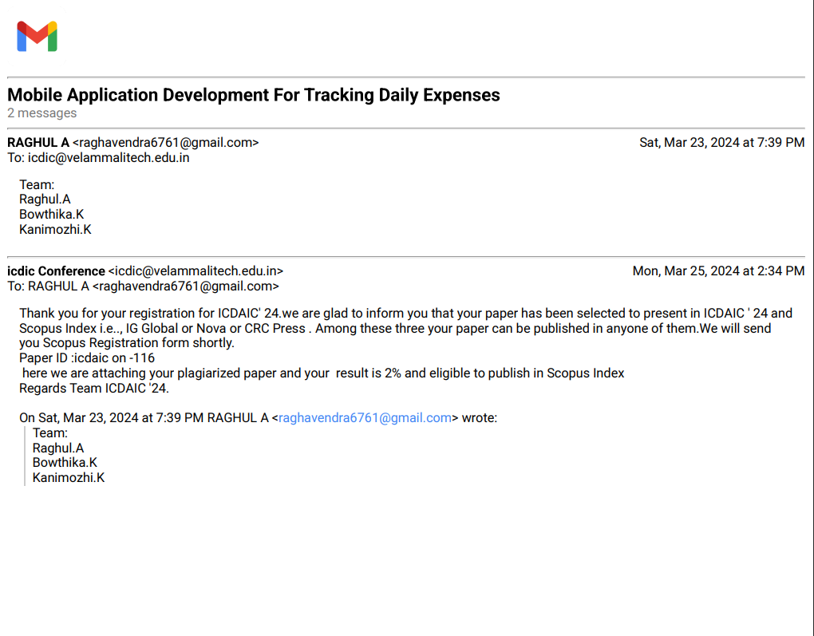
CONFERNCE REGISTRATION MAIL

Slide 15
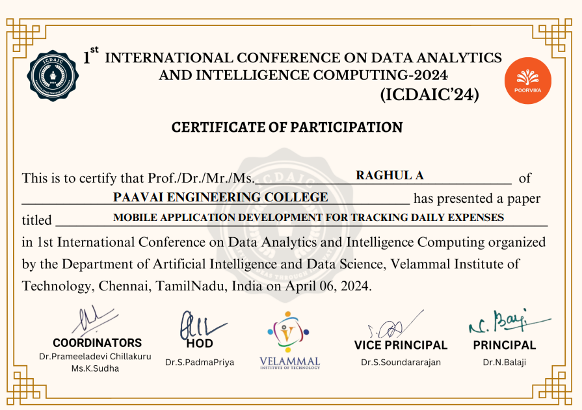
CONFERNCE CERTIFICATE

Slide 16
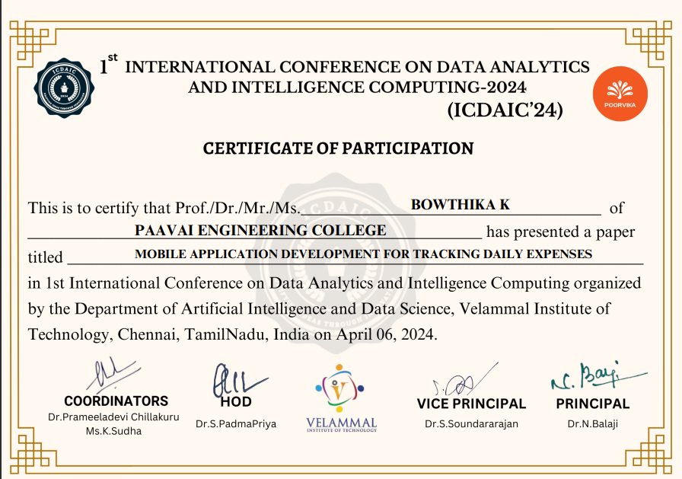
CONFERNCE CERTIFICATE

Slide 17

COMPLETION CERTIFICATE

Slide 18
THANK YOU

